Slide 1
Communication Crossroads: The Unanticipated Consequences of Assessment
Donna Handley, David Harding, Catherine Reese
Master of Public Administration (MPA) Program
College of Arts & Sciences

Slide 2
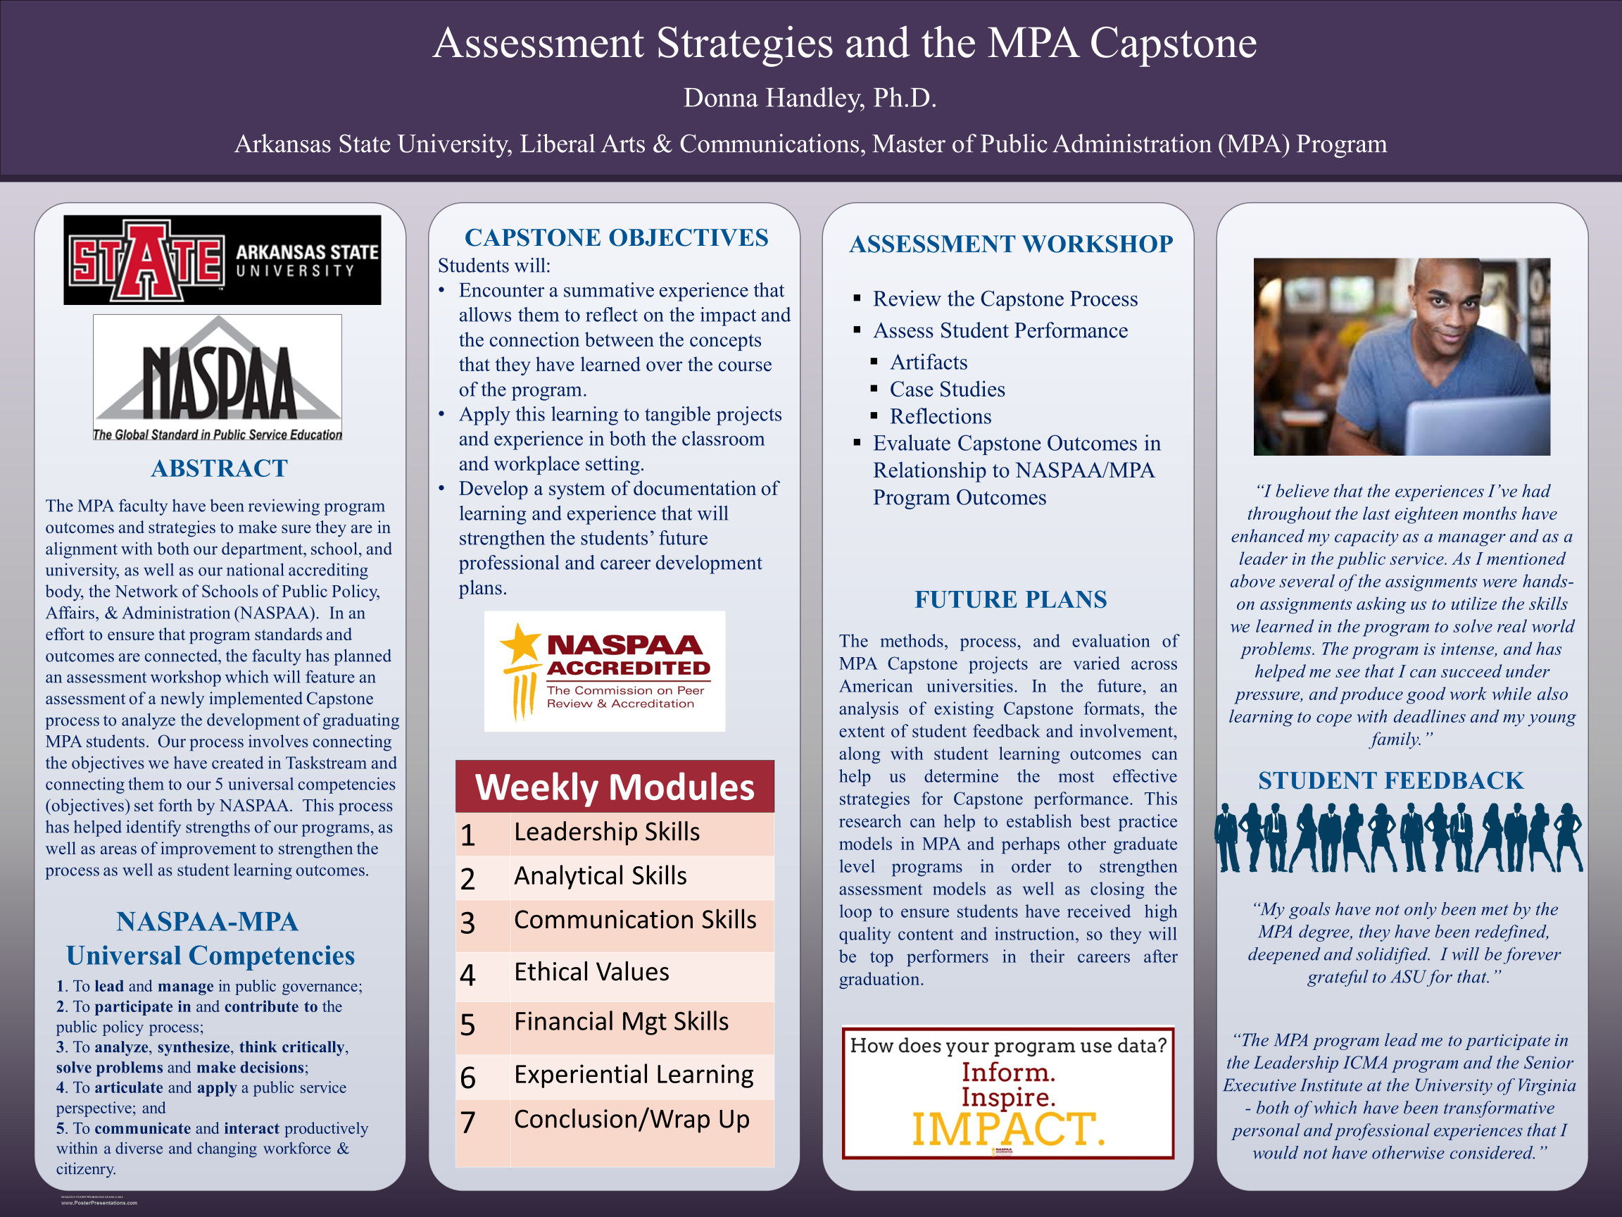
2018

Slide 3
Year in Review: 2018
Focus on 5 Universal Competencies
Data Review
Student Documentation and Reflection
AState Assessment guidelines
PHASE I
Learning

Slide 4
Current Year: 2019
Connect the Outcomes:
  Accreditation (Universal Competencies) with AState Assessment
Gather More Data:
  Student Documentation and Reflection
Revise our AState Assessment Process
PHASE II
Streamlining

Slide 5
Next Year: 2020
Complete our Review of Program/Learning Outcomes:
  First Cycle complete
Review the Data:
  Solidify Performance Measures/Documentation
  Revise as needed
Set Benchmarks
PHASE III
Closing the Loop

Slide 6
Unanticipated Outcomes
We used the Office of Assessment syllabi evaluations to initiate program/quality improvement measures
Lessons learned:
  Keep adjuncts informed
  Reconcile program accreditation needs with HLC needs
  Update and manage compliance records
  The need for consistent communication among faculty members to enhance quality and accomplish program goals and student learning outcomes
PHASE III
Closing the Loop

Slide 7
Thank you!

